Slide 1
News Sharing
预告
第8周辩论：同性婚姻在中国是否应该合法化？
Should same-sex marriage be legalized in China?
Week 9： quiz 1（新闻相关知识10 个选择题; 词汇5 个独立句子，每个填一个单词,从10个选项选择；阅读一篇文章 5个选择题。）

Slide 2
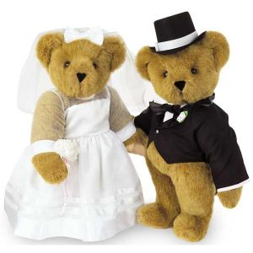
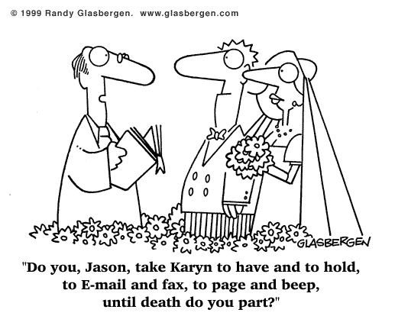
Oral Work
Debate: Should same-sex marriage be legalized in China?

Slide 3
Formal Debate
Steps of an English debate
Step one: say your opinion
1. The first debater in pros speaks. (about 2-3 minutes)
2. The first debater in cons speaks. (about 2-3 minutes)
Step two: ask questions to each other & free debate
The pros speak first, then the cons speak.
Pros and cons take turns to speak.(2-3 minutes/person)
Step three: sums up all the arguments
1. The fourth debater in cons speaks.
2. The fourth debater in pros speaks.(2-3 minutes/person)

Slide 4
Informal Debate
Step one: State your opinion
The first debater in pros states your opinion and one reason.
The first debater in cons states your opinion and one reason.
Step two: Free debate
Pros and cons take turns to speak with only one refutation or one argument each time.
Total number of logical arguments (论据) and effective refutations (驳斥) of each side.

Slide 5
An argument is a statement or set of statements that you use in order to try to convince people that your opinion about something is correct. 论据
A refutation of an argument, accusation, or theory is something that proves it is wrong or untrue. (对观点、指责或理论的)驳斥; 反驳

Slide 6
Should same-sex marriage be legalized in China?
Pro-side
Arguments: 5
Refutations：6
Total: 11
Con-side
Arguments: 8
Refutations：2
Total: 10

Slide 7
Oral Work
Debate: Should same-sex marriage be legalized in China?
Debaters: 8; 4 in pro and con-side.
Host: 1
Volunteers? To be announced via QQ
Watch the video and read other materials to prepare for the debate.

Slide 8
Watch the video:
“What’s Morally Wrong with Homosexuality”
What is the speaker’s opinion on homosexuality?
Note down the arguments the speaker made or refuted.
Which argument do you think is the strongest? And which is the weakest? How can you refute it?
Which argument are you most interested in?
Get ready to share your answers with your partner and the whole class next class.

Slide 9
New Words
Disconcerting: 令人不安，打扰人的
What’s all the fuss about: 有什么大惊小怪的
Darn: 非常地
Leviticus利未记，圣经《旧约全书》中的一卷
Abomination：憎恨，犯法
Adultery: 通奸行为
Pyrometer：高温计
Humping：蹭
Flaunting it：嚣张
Perverted：扭曲
Consenting adults：自愿同意的成年人

Slide 10
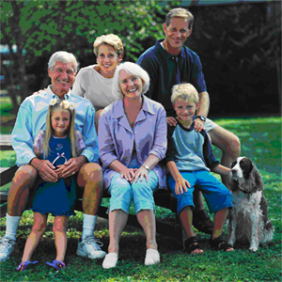
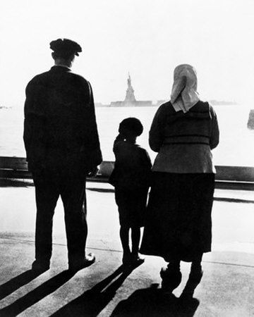
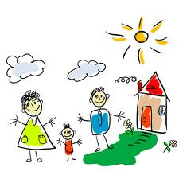
Unit five
Marriage and family life

Slide 11
Read the news carefully and complete the tables.
Knowledge
on same-sex
marriage
Identity
Opinions on gay marriage
(Para. & line)
President
Advanced
degree in
comparative
labor history
Tried to be an
informed
person
Arguments on well-being of children:
David
Blankenhorn
Argument on the stability
of marriage:
1. Para 5, line 2
2. Para. 5 line 4
3. Para. 7 line 1
Para. 10. line 2
Majored in law.
Argument on Blankenhorn’s testimony
David
Boies
A lawyer
Para.12 line 2

Slide 12
A. The process of the trial
B. Interesting sidelights of the debate
C. Background of the two characters-Blankenhorn & Boies
D. Blankenhorm’s argument on the condition of marriage itself
E. Blankenhorn’s argument on the influence of marriage on children’s well-being
1: 2-4
2: 5-7
3: 8-9
4: 10-11
5: 12-14

Slide 13
Reading Activities
Read the headline of the following article and suggest questions you want answered in the article, and then write down the questions in the space below.
Skim through the article quickly and find the answers to the questions you have written down above.
Five questions?

Slide 14
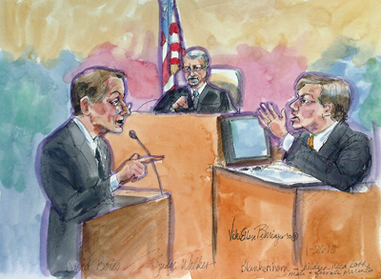
Read the headline
who
what
Witness Says Gay Marriage Would Help Children
Who is the witness?
What is his opinion?
Why did he say so?

Slide 15
Lead paragraph
what
Allowing same-sex couples to get married would improve the well-being of children raised by gay parents but should not be pursued as social policy because it would further weaken marriage as an institution, the head of a private think tank testified during a federal trial challenging California’s gay marriage ban.
who
when
why

Slide 16
Language Points: Terms in court/Legal Terms
Testify; trial 审理; witness (para. 1)
Take the stand; sponsor 赞助商; initiative 主动权; proposition; legitimate 合法的(para. 2)
cross-examination, sue 控告, ballot, discredit 怀疑 (para 3)
Legalize (para 6.)

Slide 17
evidence phase; Deny sb. The right to do sth; wrap up; defense lawyers; federal court 联邦法院 (para 8)
Chief U.S. Judge, hear, testimony/testify, closing argument (para 9)
Tense exchange; nuanced; intervene (para 12)
Snap; counter (para. 13-14)

Slide 18
Special Focus
Proposition 8: It provides that “only marriage between a man and a woman is valid or recognized in California 第八号提案
Para 1: California’s gay marriage ban
Para 2: the ban; the voter-approved initiative
Para 3: the 2008 ballot measure
Para 8: if the U.S. Constitution prohibits denying gays and lesbians the right to wed

Slide 19
News Structure
1. Para2-4: Background of the two characters--Blankenhorn & Boies:
2. Para5-7: Blankenhorn’s argument on the influence of marriage on children’s well-being
3. Para.8-9: The process of the trial
4. Para 10-11: Blankenhorm’s argument on the condition of marriage itself
5. Para 12-14: Interesting sidelights of the debate

Slide 20
Find out all the opinions of the witness and the lawyer and complete the tables.
Knowledge
on same-sex
marriage
Opinions on gay marriage
(Para. & line)
Identity
President
Witness
Advanced
degree in
comparative
labor history
Arguments on well-being of children:
David
Blankenhorn
Argument on the stability
of marriage:
1. Para 5, line 2
2. Para. 5 line 4
3. Para. 7 line 1
Para. 10. line 2
A lawyer
Accuser
Majored in law.
Lead Lawyer
Argument on Blankenhorn’s testimony
David
Boies
Para.12 line 2

Slide 21
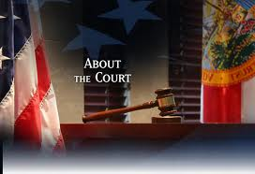
Part 1: Para. 2—4 (facts and quotes)
The background information about the trial, including the purpose of the trial, the law (Proposition 8) challenged in the trial, and the background of expert witness of the defendant.

Slide 22
Words and terms difficult to understand
P1: testify: to state or affirm under oath 作证
ban: a prohibition imposed by law or official decree. 禁令
P3: discredit: to cause to be doubted or distrusted. 使被怀疑

Slide 23
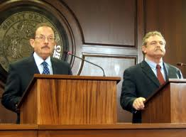
Part 2: Para. 5-7 (direct and indirect quotes)
The witness released the key statement that same-sex marriage would benefit the children under the cross-examination of the accuser’s lawyer.

Slide 24
Words:
P5: fare: To get along 进行
  P6: household: A domestic unit consisting of the members of a family who live together along with nonrelatives such as servants. 家庭

Slide 25
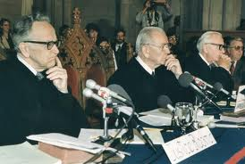
Part 3: Para.8-9 (facts and indirect quotes)
More background information about the trial (the significance of the trial, the time of it’s close and the judge of the trial)

Slide 26
Words:
  P8: wrap up: come to an end 结束 ，完成
  P9: hear: To listen to in an official, professional, or formal capacity 审理，听证
  testimony: A declaration by a witness under oath, as that given before a court. 证词

Slide 27
Para. 10-11 (opinions and direct quotes)
Further information about the witness’ related opinions about possible negative impact of homosexual marriage.

Slide 28
Words:
  P10: tenuous : thin 单薄的
  polygamy: the condition or practice of having more than one spouse at one time. 多配偶（制）

Slide 29
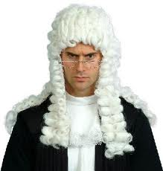
Para. 12-end (facts and direct quotes)
Minor details about the tense court debate between the witness and the accuser’s lawyer.

Slide 30
Words:
P12: nuanced:有细微差别的
P 13: snap : to utter abruptly or sharply 突然且严厉地说出
P 14: counter: to offer in response 反驳，回答

Slide 31
Result of the suit?
Guess?

Slide 32
Judge Overturns Gay Marriage Ban
1. Why were those voters who banned gay marriage wrong?
2. What makes the voters wrong according to Judge Walker?
3. How many states in US have approved same-sex marriage?
4. What are the reactions of proponents and opponents?

Slide 33
Good evening breaking news tonight in the America's national debate about what defines a family. Two years ago the voters of California banned gay marriage with 52% of the vote. This afternoon a federal judge said those voters were wrong. That banning gay marriage is fundamentally unconstitutional and violates America's commitment to end discrimination. A decision that will undoubtedly head to the Supreme Court and Terry Moran has been studying it all for us.

Slide 34
Federal judge Vaughn Walker ruling with sweeping and definitive striking down the ban on same-sex-marriage in ringing terms because California has no interest in discriminating against gay men and lesbians, the court concludes that Proposition 8 is unconstitutional. By striking down Proposition 8, judge Walker a republican appointee, declared that the 7 million Californians who voted for the ban got it wrong constitutionally.

Slide 35
Voters, he said, were driven by nothing more than a fear or unarticulated (不善表达的) dislike of same-sex couples, adding opposite-sex couples are not better than their same-sex counterparts instead, as partners, parents and citizens opposite-sex couples and same-sex couples are equal. Reaction was swift and intense from the Lesbian couple that brought the case, jubilation(欢呼).
“This decision says that we are Americans, too. We too should be treated equally.” (Plaintiff, Accuser, Claimant: Kristin Perry)

Slide 36
Their lawyers were a high-powered political-like couple. Democrat David Boies who represented Al Gore in the 2000 election dispute and Republican Ted Olson worked for George W. Bush in that case. But they found common ground in fighting for the rights of gays and lesbians.
“This is what American's justices all about.” (Co-Councilor Ted Olson )

Slide 37
On the other side, there was anger. And in this election year republican is seeing an opening.
Senator Jeff Sessions of Alabama blasted (=hit hard, criticize) the ruling: “This is an example of a judge feeling that they know better than their people what higher and better values are.”
Now the judge stayed his ruling from going into effect, so there will be no gay marriages in California just. Yeah, this case headed for an appeal （上诉）dying no question, all the way to the supreme court.

Slide 38
But I wanna show everybody the map right now, Terry, as if of tonight there are five states that have already approved same-sex marriage. They are Massachusetts, Connecticut, Iowa, New Hampshire, Vermont and, of course, Washington DC as well. So tell us what the courts have been saying about this nation-wide.

Slide 39
Well there's no question, Diane. this is a movement right now being driven in the courts and proponents say that that is where the courts' aware of our fundamental rights have always been advanced and protected. Opponents of same-sex marriage say this is just anti-democratic at the latest. And there is a risk of a backlash (集体反对), Diane, when the courts get too far ahead of the country. They risk their legitimacy, their authority. Right now, the country is divided on this,50 to 47 against same-sex marriage in the latest ABC news poll. It will be very interesting to see what happens to those numbers away...

Slide 40
But are you saying the courts have not ruled against (否决)it so far in states?
They have not. The Hawaii Supreme Court did dismiss a case that didn't rule our constitutionality. But right now it's a string of victories in the courts.

Slide 41
Part II News Lead

Slide 42
I. About Leads page 81
Definition:
The opening paragraph or two of the story is called the “lead”.

Slide 43
Categories
In a hard news story, the lead should be a full summary of what is to follow. It should incorporate as many of the 5 W’s of journalism (who, what, when, where and why) as possible.
In a soft news story, the lead should present the subject of the story in a somewhat literary manner to draw the reader in.

Slide 44
Which one is a hard news lead?
1. Will teachers be the latest profession to be automated out of their jobs by computers? A new online education system will allow students to teach themselves math and physics by playing video games.
2. President Obama arrived in on Thursday morning to formally accept the Nobel Peace Prize and to attend a daylong series of events to commemorate the award.

Slide 45
Functions
Capture the essence of your story
Encourage the reader to continue

Slide 46
What is a successful lead?
A lead paragraph is a mini-story.
  Succinct
  Informative
  Intriguing

Slide 47
Identifying elements in News leads
Identify all six elements in the following example.
1. On Friday, a team of doctors began working to separate the twin sisters who were born five months ago joined at the abdomen and chest. The surgery at the Mayo Clinic in Rochester, Minnesota, was expected to take 10 to 12 hours. (CNN, Friday, May 12, 2006)

Slide 48
On Friday, a team of doctors began working to separate the twin sisters who were born five months ago joined at the abdomen and chest. The surgery at the Mayo Clinic in Rochester, Minnesota, was expected to take 10 to 12 hours. (CNN, Friday, May 12, 2006)
Who: a team of doctors
What: began working to separate the twin sisters
When: On Friday (May 12, 2006)
Where: at the Mayo Clinic in Rochester, Minnesota
Why: the twin sisters who were born five months ago joined at the abdomen and chest
How: by The surgery

Slide 49
Identifying the topic in News leads
BEIRUT, Lebanon (Reuters) --- Iraq, in the hope of getting peace negotiations started, announced today that the last of its soldiers had left Iran.
This story is about _______.
  peace negotiations.
  Iranian soldiers
  an Iraqi announcement
√

Slide 50
II. News headlines and leads
Lead is an expanded detail of headline.
Headline is the brief conclusion of lead.

Slide 51
Predict the headlines with the help of given leads.
Exercise
Rich find in Ireland
DUBLIN (Reuters) --- A hoard （储藏）of eighth century treasure, including a priceless silver and gold chalice (圣餐杯), has been found in an Irish bog, the Government announced Thursday.

Slide 52
Rice Asserts U.S. Plans No Attack on North Korea
WASHINGTON, Oct. 10 — Secretary of State Condoleezza Rice said Tuesday that the United States did not intend to invade or attack North Korea, but she warned the North’s leaders that they now risked sanctions （制裁）“unlike anything that they have faced before.”

Slide 53
New light shed on Kennedy shooting
WASHINGTON (Reuters) --- A new theory that four shots, not three, may have been fired when President Kennedy was assassinated (刺杀）is being studied in an attempt to show that Lee Harvey Oswald, his accused assassin, did not act alone.

Slide 54
China Makes Commitment to Social Harmony
BEIJING, Oct. 11 — China’s Communist Party, devoted in recent years to expanding the economy at any cost, on Wednesday endorsed（签署） a new doctrine（声明）that puts more emphasis on tackling the severe side effects of unrestrained.（无限制的）growth.

Slide 55
Task 1 Browse the news website: www.chinadaily.com.cn
Read news on the internet.
Identify the information of 5ws.
Observe how headlines and leads are related.
Share the information with your partner.
You can copy the news lead and analyze it on your notebook.

Slide 56
Task 2 News lead writing

Slide 57
I. News Lead Expansion:
How can 3 words be expanded to 32 words?
A bus fell.
+（where） +（when） +（what result） +（why） +（who）+（what route） + (what kind of bus)

Slide 58
A bus fell.
1. +（where）
A bus fell into a lake near Montreal.
2. +（when）
An bus fell into a lake near Montreal late yesterday.
3. +（what result）
An bus fell into a lake near Montreal late yesterday, killing 41 of the 48 persons aboard.
4. +（why）
An out-of-control bus fell into a lake near Montreal late yesterday, killing 41 of the 48 persons aboard.

Slide 59
5. +（who）
An out-of-control charter bus, carrying a group of mentally-retarded and handicapped people, fell into a lake near Montreal late yesterday, killing 41 of the 48 persons aboard
6. +（what route）
An out-of-control bus, carrying a group of mentally-retarded and handicapped people home from a theater outing, fell into a lake near Montreal late yesterday, killing 41 of the 48 persons aboard.
7. + (what kind of bus)
An out-of-control charter bus, carrying a group of mentally-retarded and handicapped people home from a theater outing, fell into a lake near Montreal late yesterday, killing 41 of the 48 persons aboard.

Slide 60
A bus fell.
An out-of-control charter bus, carrying a group of mentally-retarded and handicapped people home from a theater outing, fell into a lake near Montreal late yesterday, killing 41 of the 48 persons aboard.

Slide 61
A bus fell.
+（where）A bus fell into a lake near Montreal.
+（when）An bus fell into a lake near Montreal late yesterday.
+（what result）An bus fell into a lake near Montreal late yesterday, killing 41 of the 48 persons aboard.
+（why）An out-of-control bus fell into a lake near Montreal late yesterday, killing 41 of the 48 persons aboard.
+（who）An out-of-control charter bus, carrying a group of mentally-retarded and handicapped people, fell into a lake near Montreal late yesterday, killing 41 of the 48 persons aboard
+（what route） An out-of-control bus, carrying a group of mentally-retarded and handicapped people home from a theater outing, fell into a lake near Montreal late yesterday, killing 41 of the 48 persons aboard.
+ (what kind of bus) An out-of-control charter bus, carrying a group of mentally-retarded and handicapped people home from a theater outing, fell into a lake near Montreal late yesterday, killing 41 of the 48 persons aboard.

Slide 62
News Leads Writing
Exercise 1
Write a lead for a story from each of the following set of facts by applying the basic points you have learned about the lead, WHO,WHAT,WHEN, WHERE, etc:

Slide 63
Story 1
Taobao Mall Co
expects its transaction to rise
next year
by teaming up with smaller rivals

Slide 64
Suggested Answer:
BEIJING - Taobao Mall Co, China's biggest retail website for businesses to sell to customers, expects its transaction volume to double to 200 billion yuan ($31.3 billion) next year, boosted by initiatives such as teaming up with smaller rivals.

Slide 65
Exercise 2
Directions: write news leads based on the given news headlines.
i) read the news headline,
ii) speculate what is happening in the news story, and
iii) write a new lead based on your speculation.
Your lead should include expanded information than the headline does.
5.5-magnitude quake hits Xinjiang

Slide 66
Suggested answers:
5.5-magnitude quake hits Xinjiang
An earthquake measuring 5.5 on the Richter scale jolted Yutian County in Hotan Prefecture in northwest China's Xinjiang Uygur Autonomous Region at 11:27 p.m. Beijing Time on Thursday, said the China Earthquake Networks Center.

Slide 67
Homework
Review Unit 5 and finish Word Building. Refer to Vocabulary in Unit 5.
下周上课前必须完成：
第五单元阅读练习.
新闻英语基础知识练习4—新闻导语.
下周安排
辩论
复习前三个单元。
复习新闻基础知识练习1/2/3/4

